Slide 1


Institute of Industrial Automation
and Software Engineering
Deep Learning-based Monitoring of Urban Traffic using MOBATSim
Presented by: Nikita Jhawar
Supervised by: Sheng Ding
Examined by: Jun.-Prof. Dr.-Ing. Andrey Morozov

Slide 2
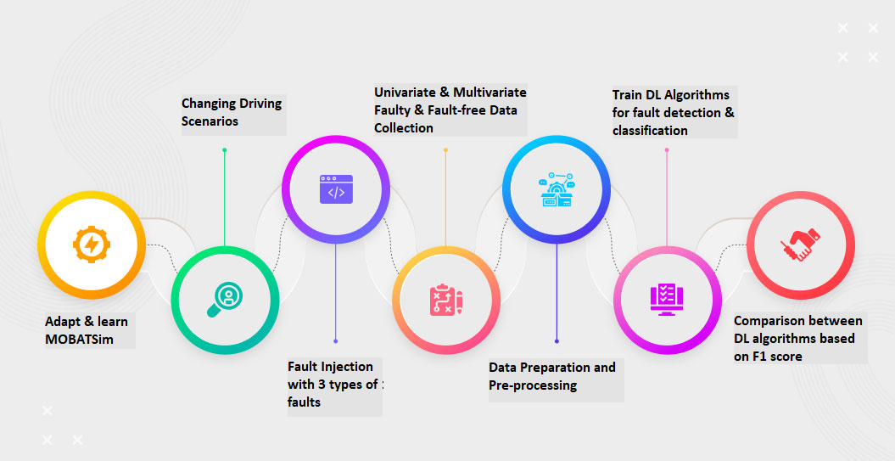
AIM OF THESIS

Slide 3

TABLE OF CONTENTS
MOTIVATION
PRE-PROCESSING
Introduction
FAULT DETECTION
USING DL MODELS
FAULT INJECTION
RESULTS
DATA COLLECTION
CONCLUSION &
FUTURE SCOPE

Slide 4
MOTIVATION

Slide 5
The automotive sector needs new tools and techniques to assess and analyze the safety of the vehicles as well as the traffic.
MOBATSim allows simulation-based
fault injection in order to evaluate
the safety of autonomous driving
systems [1].
Deep Learning-based anomaly
detection in Cyber-Physical
Systems have proved to be very
effective [2].
Automated Traffic system helps in
optimizing transport system and
make it safer.

Slide 6
The use of MOBATSim for fault error failure chain analysis has been presented using an illustrative case study showing the effects of fault types of two different sensors on the overall traffic safety as an example of the capabilities of MOBATSim [3] by injecting fault in one vehicle in the traffic model.
Related Work
.
In this thesis, we introduce injecting faults in more than one vehicle and also consider different driving scenarios for analyzing the behavior of faulty vehicles.
Thesis work

Slide 7
INTRODUCTION

Slide 8
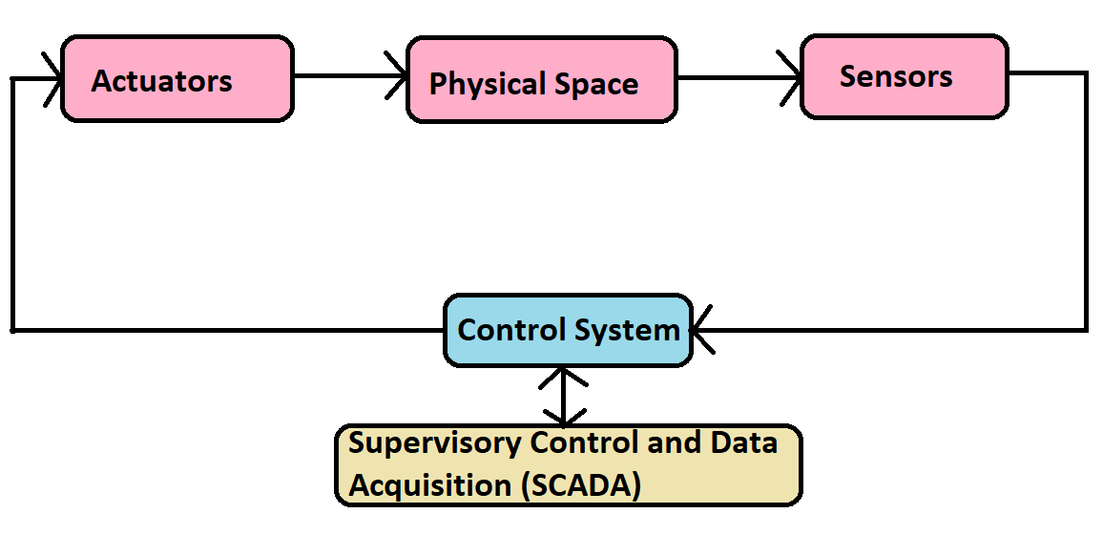
Cyber-Physical System
Cyber physical systems (CPS) is defined as systems of collaborating computational entities that are in thorough connection with the neighboring physical world as well as its ongoing processes, thus enabling data processing services [4].
MOBATSim is a type of CPS, allowing the user to develop automated driving algorithms

Slide 9



MOBATSim: Model-based Autonomous Traffic Simulation Framework
Out of these 10 vehicles, FI block is used to inject fault in 2 vehicles at speed and distance sensor.
Three types of sensor faults are injected namely Noise, StuckAt and Offset
.The MOBATSim traffic Model has 10 vehicles sharing their speed, rotation, and translation data after simulation
Simulation is run for 3 different driving scenarios with different fault values.
Two types of data i.e. Univariate and Multivariate data is collected

Slide 10
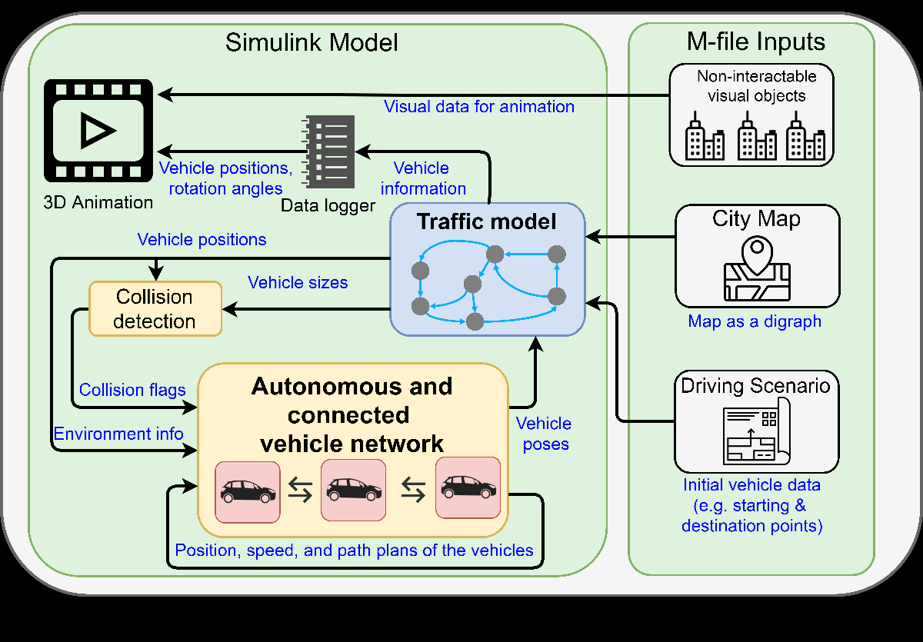
Workflow Diagram

Slide 11
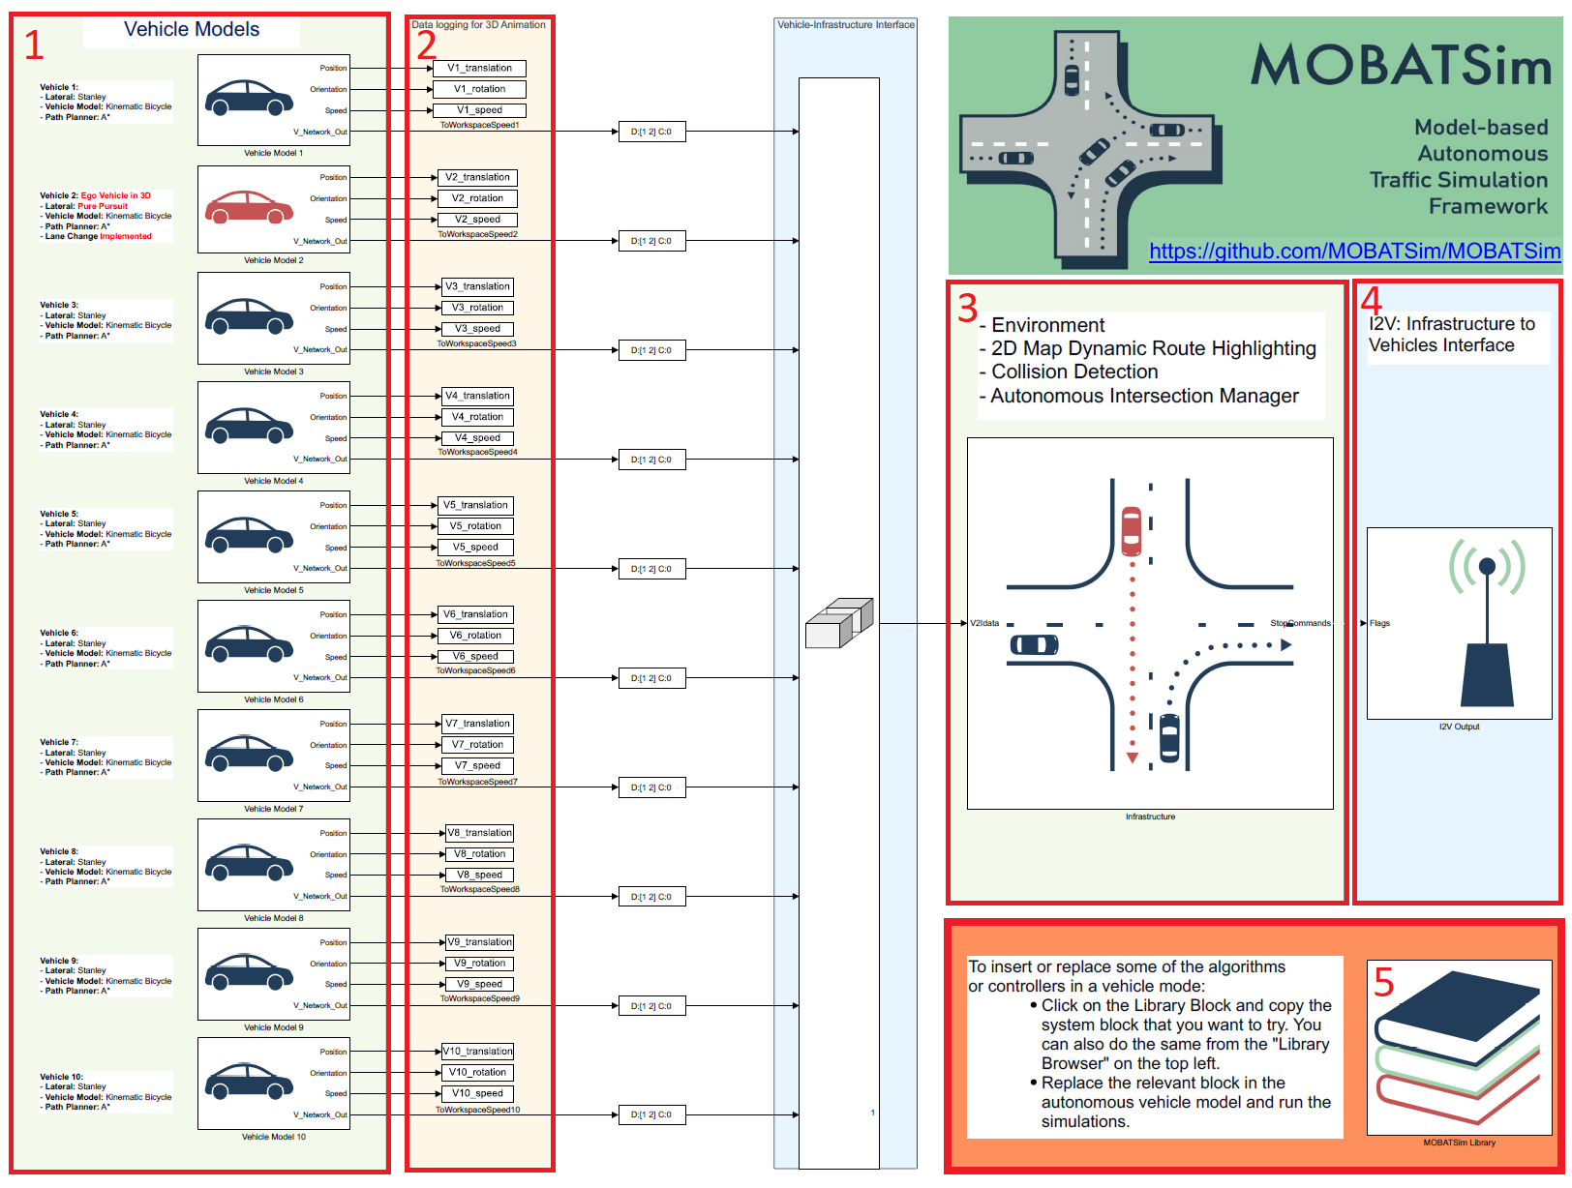
Main Simulink Model

Slide 12
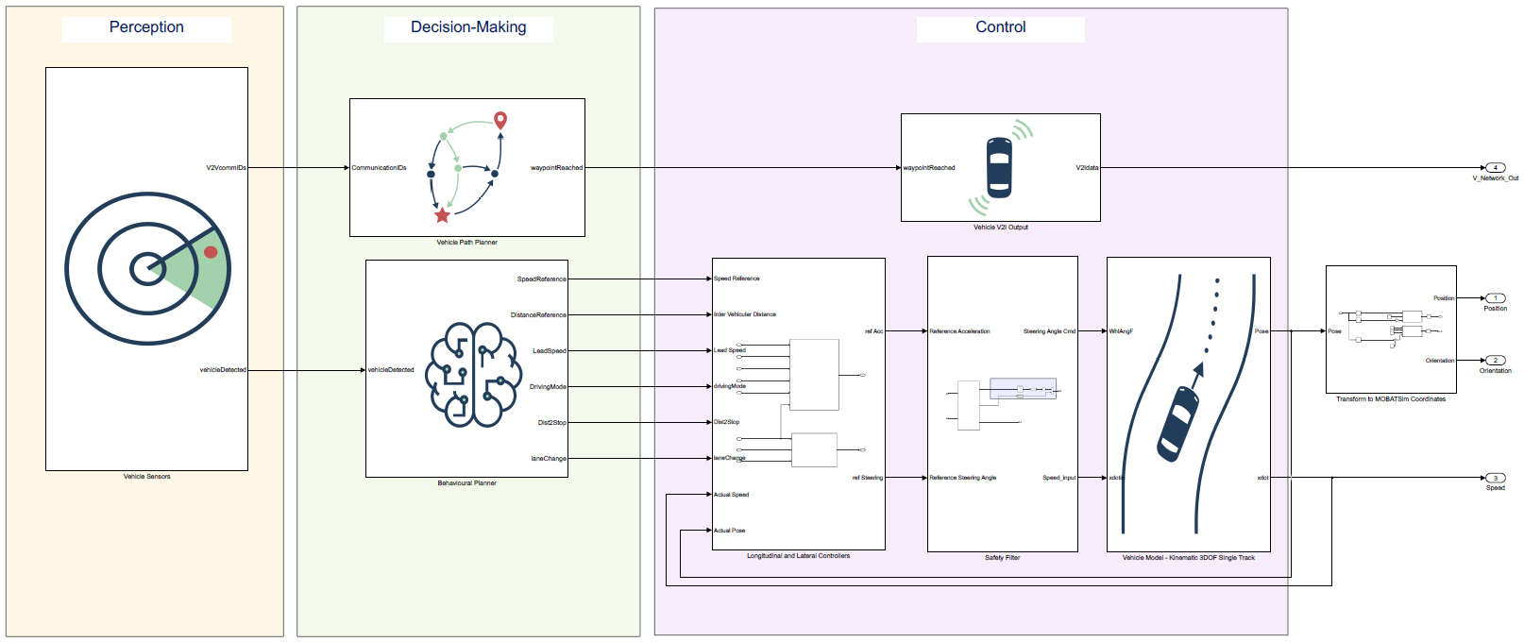
Structure of Vehicle Model

Slide 13
FAULT INJECTION

Slide 14
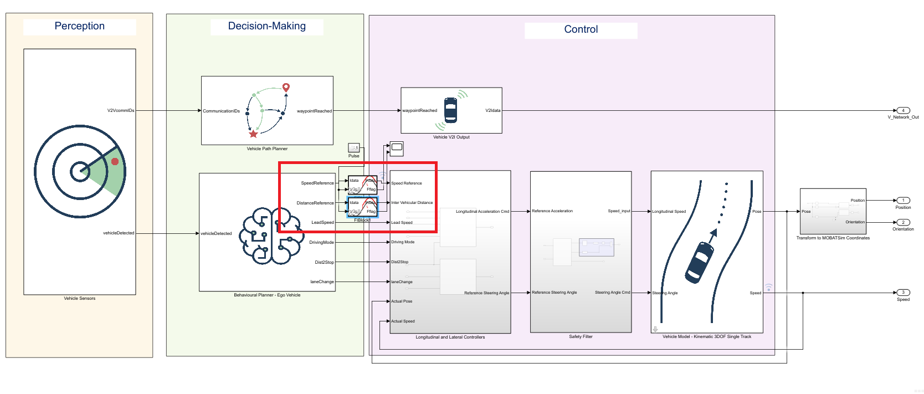
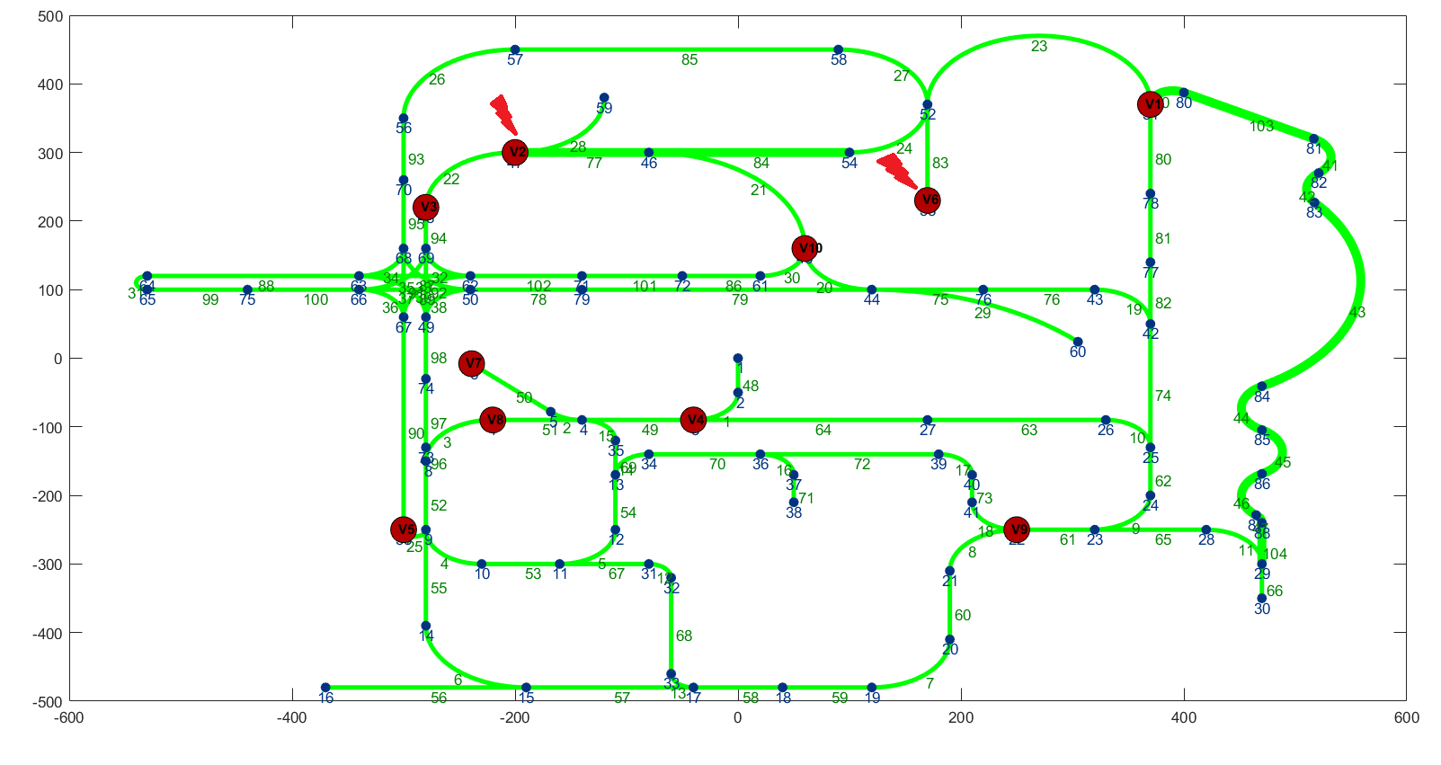
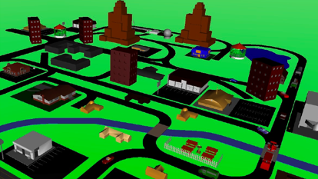
Vehicle Model After Fault Injection
Targeted Variables for Sensor faults

Slide 15
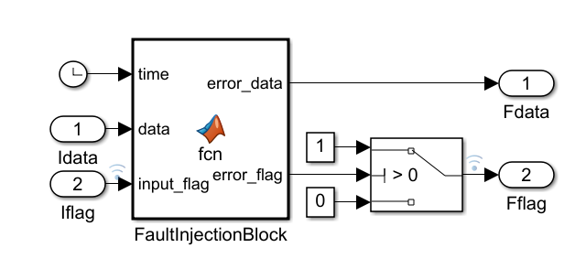
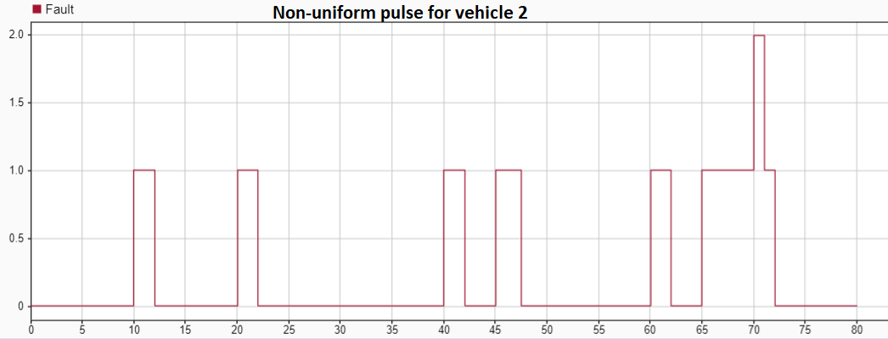
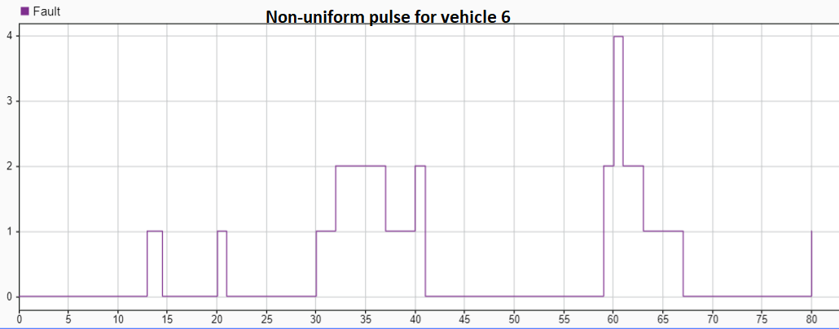
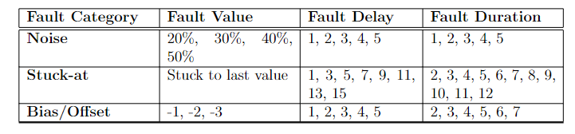
FI Block and Non-uniform Pulse Generator

Slide 16
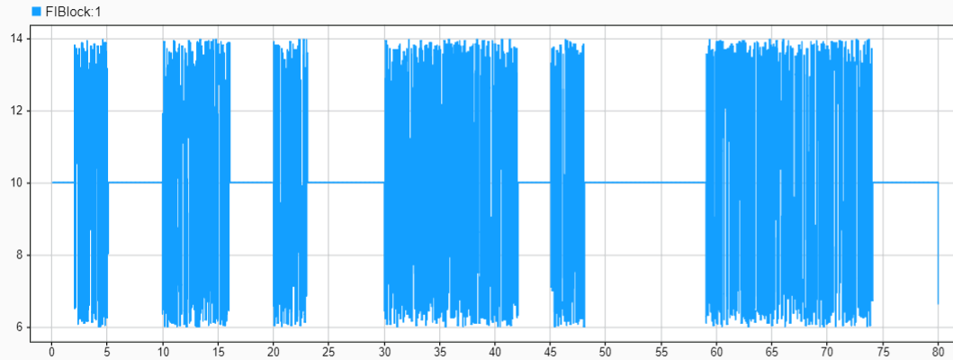
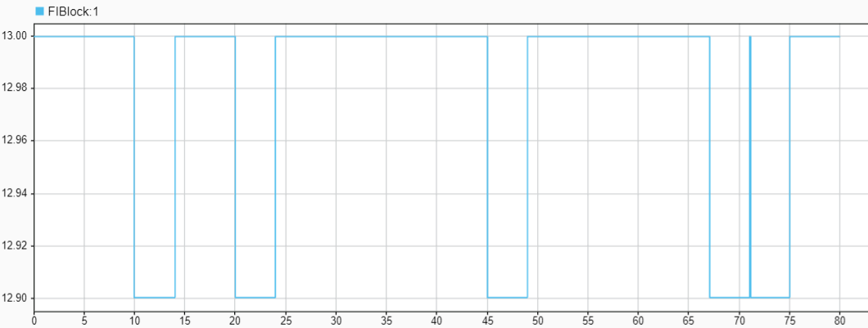
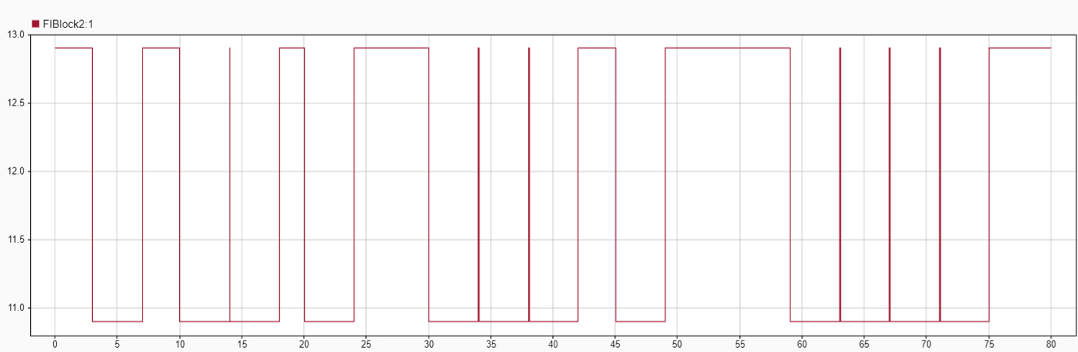
Three Categories of Fault
Noise Fault : Sampling Rate 0.02sec
Stuck-at Fault : Sampling Rate 0.02sec
Offset Fault : Sampling Rate 0.02sec

Slide 17
DATA COLLECTION

Slide 18
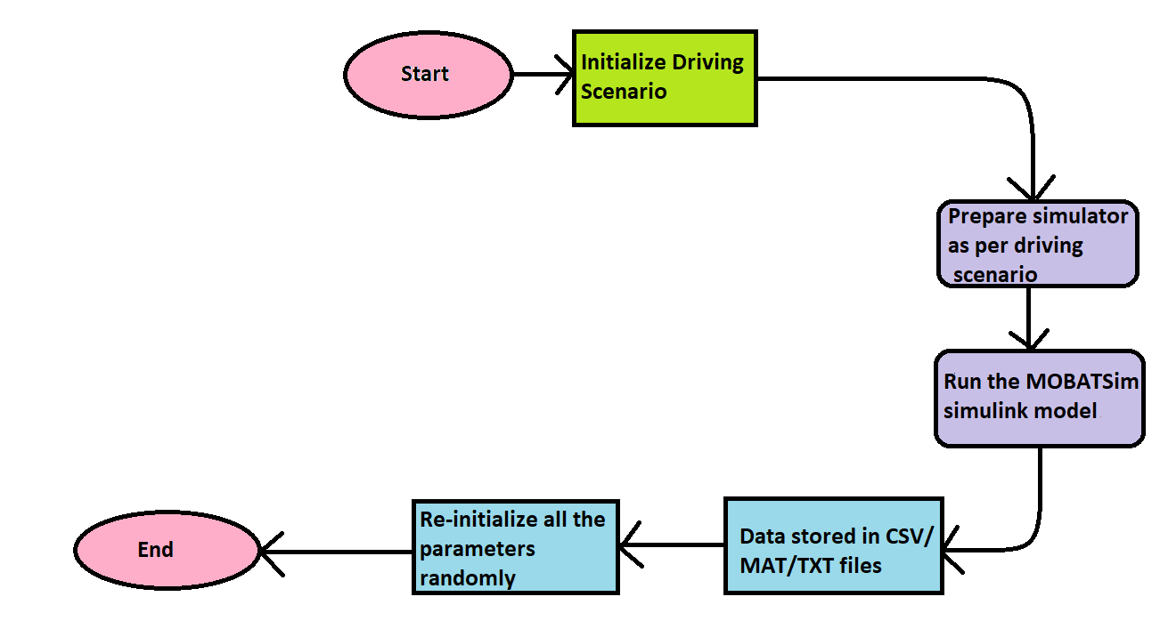
Fault-Free Data Collection
The process is repeated for three driving scenarios :
Platoon Control
Road Merge Collision
Urban City Traffic
The duration of the simulation is 80 seconds, and the data is re-sampled from 0.005 seconds to 0.02 second for data compression. Therefore, each data set generated for one simulation of 80 secs has 4000 data points (entries/rows).

Slide 19
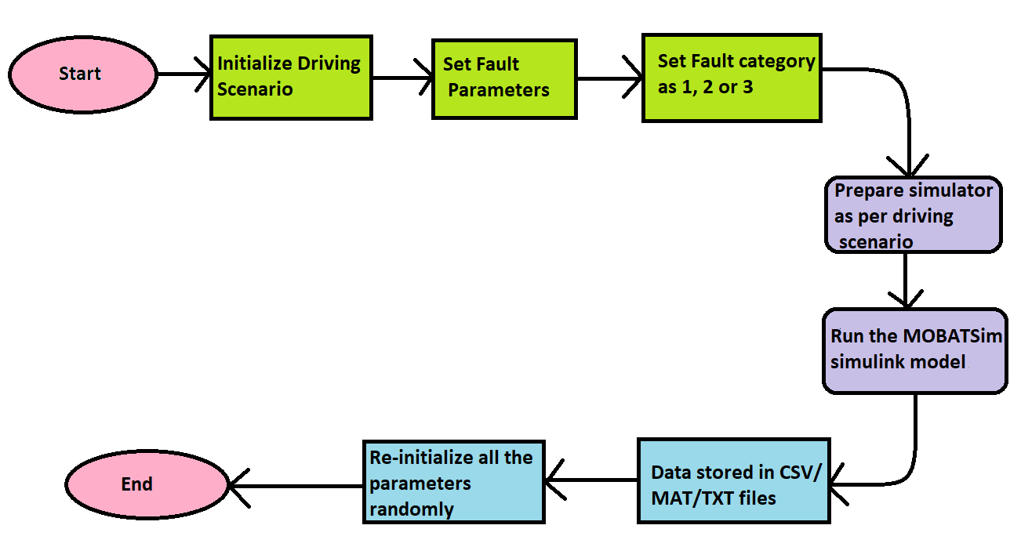
Faulty Data Collection
For each value of fault duration from the Table, data is collected for every scenario considering each fault value consecutively.
At respective fault values, data is collected for random fault delays and fault duration chosen from the table for Noise, Stuck-at and Offset/Bias for both vehicle 2 and vehicle 6 for all three scenarios.
Data is generated for each uni-variate and multivariate data. Around more than 200 faulty data files are collected with each data set generated for one simulation of 80 secs has 4000 data points

Slide 20
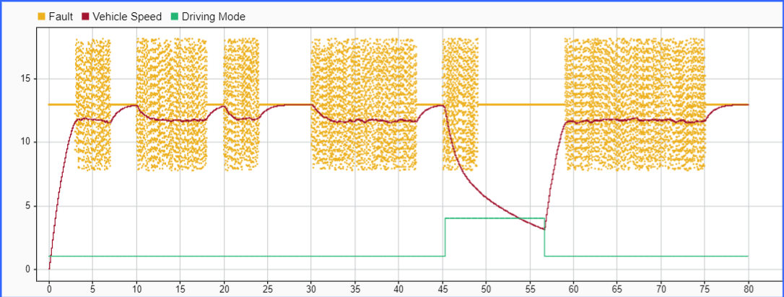
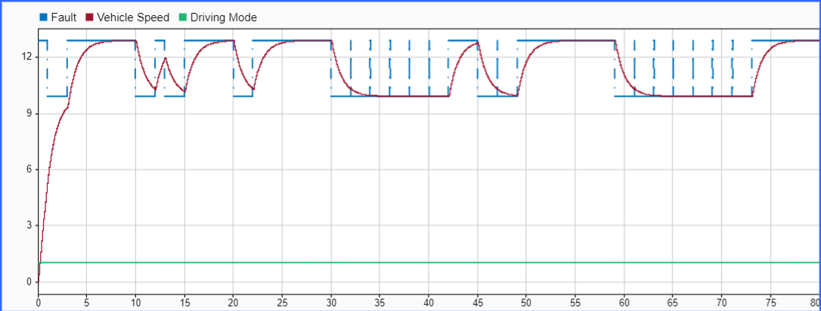
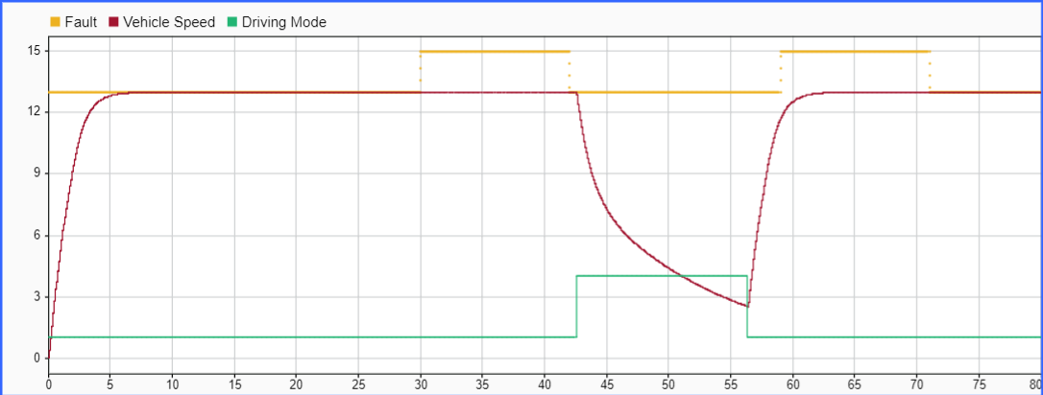
Sample Faulty Data for Vehicle 2
Noise fault injection
Offset fault injection
Stuck-At fault injection

Slide 21
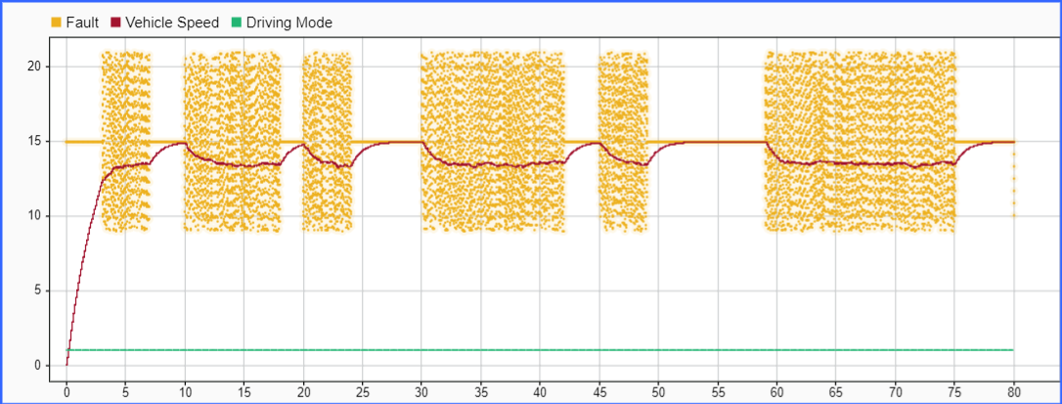
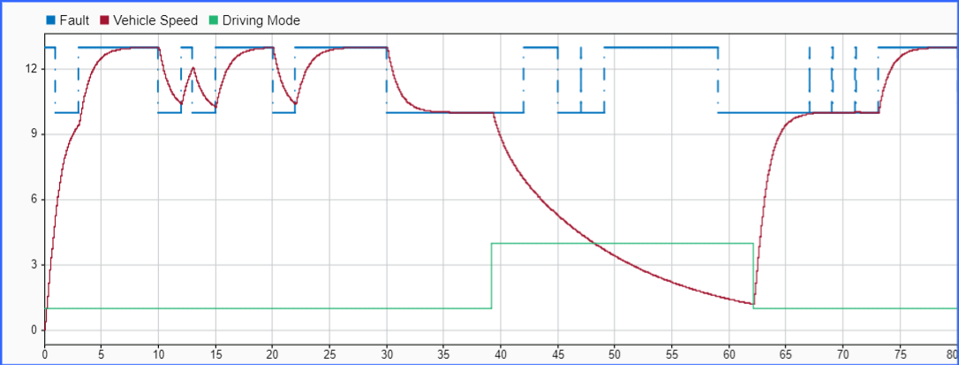
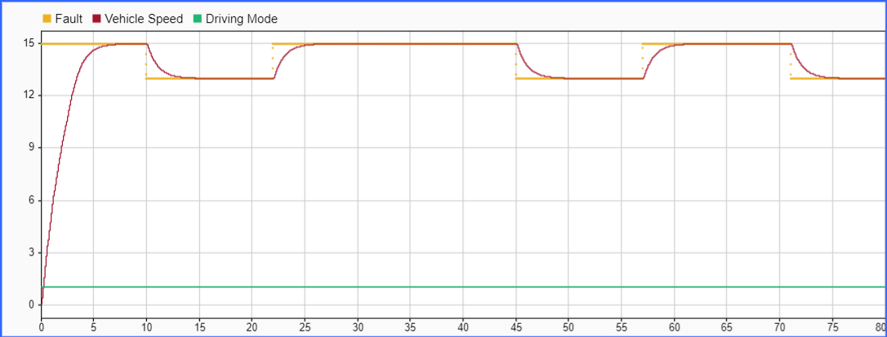
Sample Faulty Data for Vehicle 6
Noise fault injection
Offset fault injection
StuckAt fault injection

Slide 22
DATA PRE-PROCESSING

Slide 23




Data Shuffling
Categorical Conversion
The final data set is made up by concatenating all the generated simulation files in a sequential manner. In order to build a better DL model, we shuffle the data set for our further use.
Since multiple fault categories are considered, the conversion of class vector(integers) to binary class matrix for the train data set in order to use with categorical cross-entropy.
Ground Truth Labeling
Train-Test Data Split
New column Label
is introduced consisting of values 0, 1, 2 and 3 where 0 denote fault-free scenario, 1 for noise fault, 2 for stuck-at and 3 for offset..
The data is then split randomly with 0.33 part being test data and 0.67 being the train data with a random state of 42. The test data is also further split into half for assigning value to validation data.

Slide 24
FAULT DETECTION USING DL MODELS

Slide 25
Deep Learning Models Used
Recurrent Neural Network [5] consists of three types i.e., Simple RNN, Gated Recurrent Unit (GRU) and Long Short-Term Memory(LSTM).
Autoencoder is a type of neural network that is referred to learn a compressed representation of raw data as it is composed of an encoder and a decoder sub-models.
Transformer models apply an evolving set of mathematical techniques, called attention or self-attention, to detect subtle ways even distant data elements in a series influence and depend on each other.
In this thesis, we train and test our data with 6 different DL models i.e. Simple RNN, GRU-Simple RNN, BiGRU-BiSimple RNN [6], Autoencoders [9], Transformers [8], and hybrid LSTM-Autoencoders [7].

Slide 26
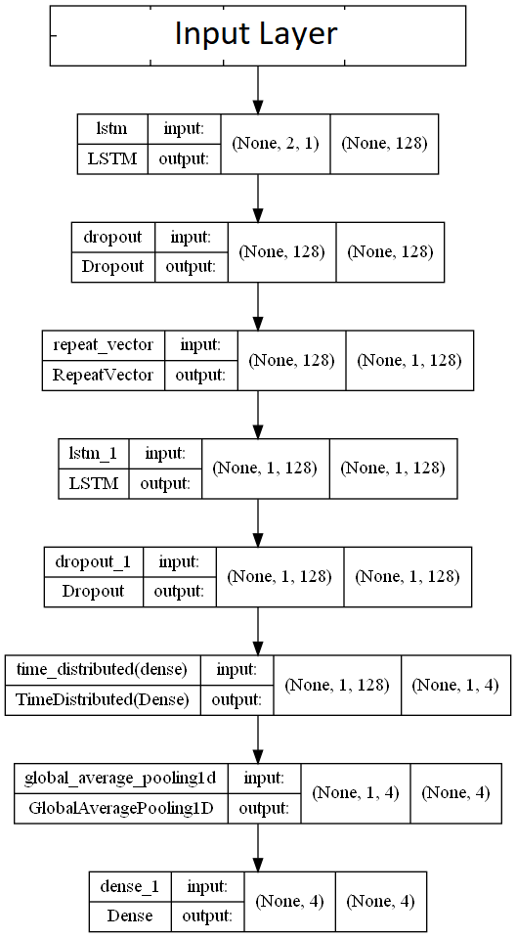
LSTM-Autoencoder Architecture
Hyper-Parameters | Value
Optimizer | Adam Optimizer
Learning Rate | 0.001
Type | Sequential
Loss | Categorical Crossentropy
Batch Size | 2048
No. of Epochs | 50

Slide 27
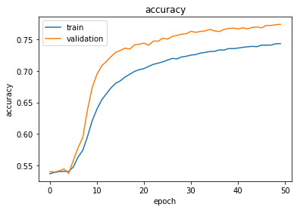
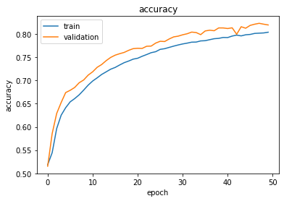
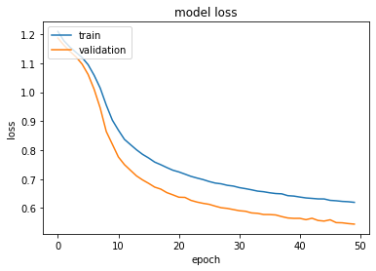
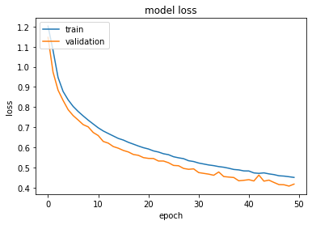
LSTM-Autoencoder Performance
Accuracy and Loss for Uni-variate Data
Accuracy and Loss for Multivariate Data

Slide 28
RESULTS

Slide 29
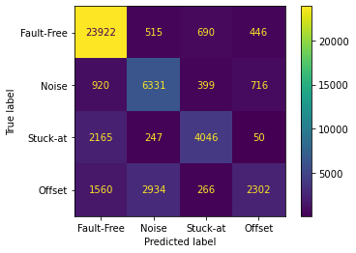
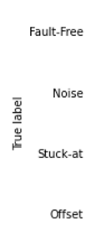
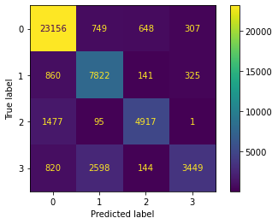
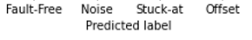
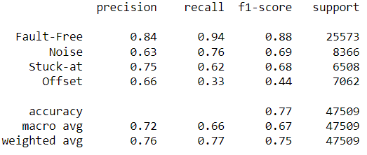
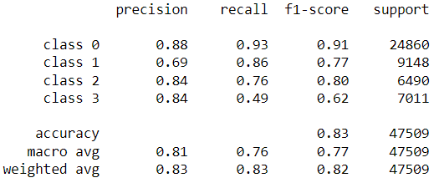
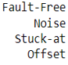
Fault Classification of LSTM-Autoencoders on Test Data
Univariate Data
Multivariate Data

Slide 30
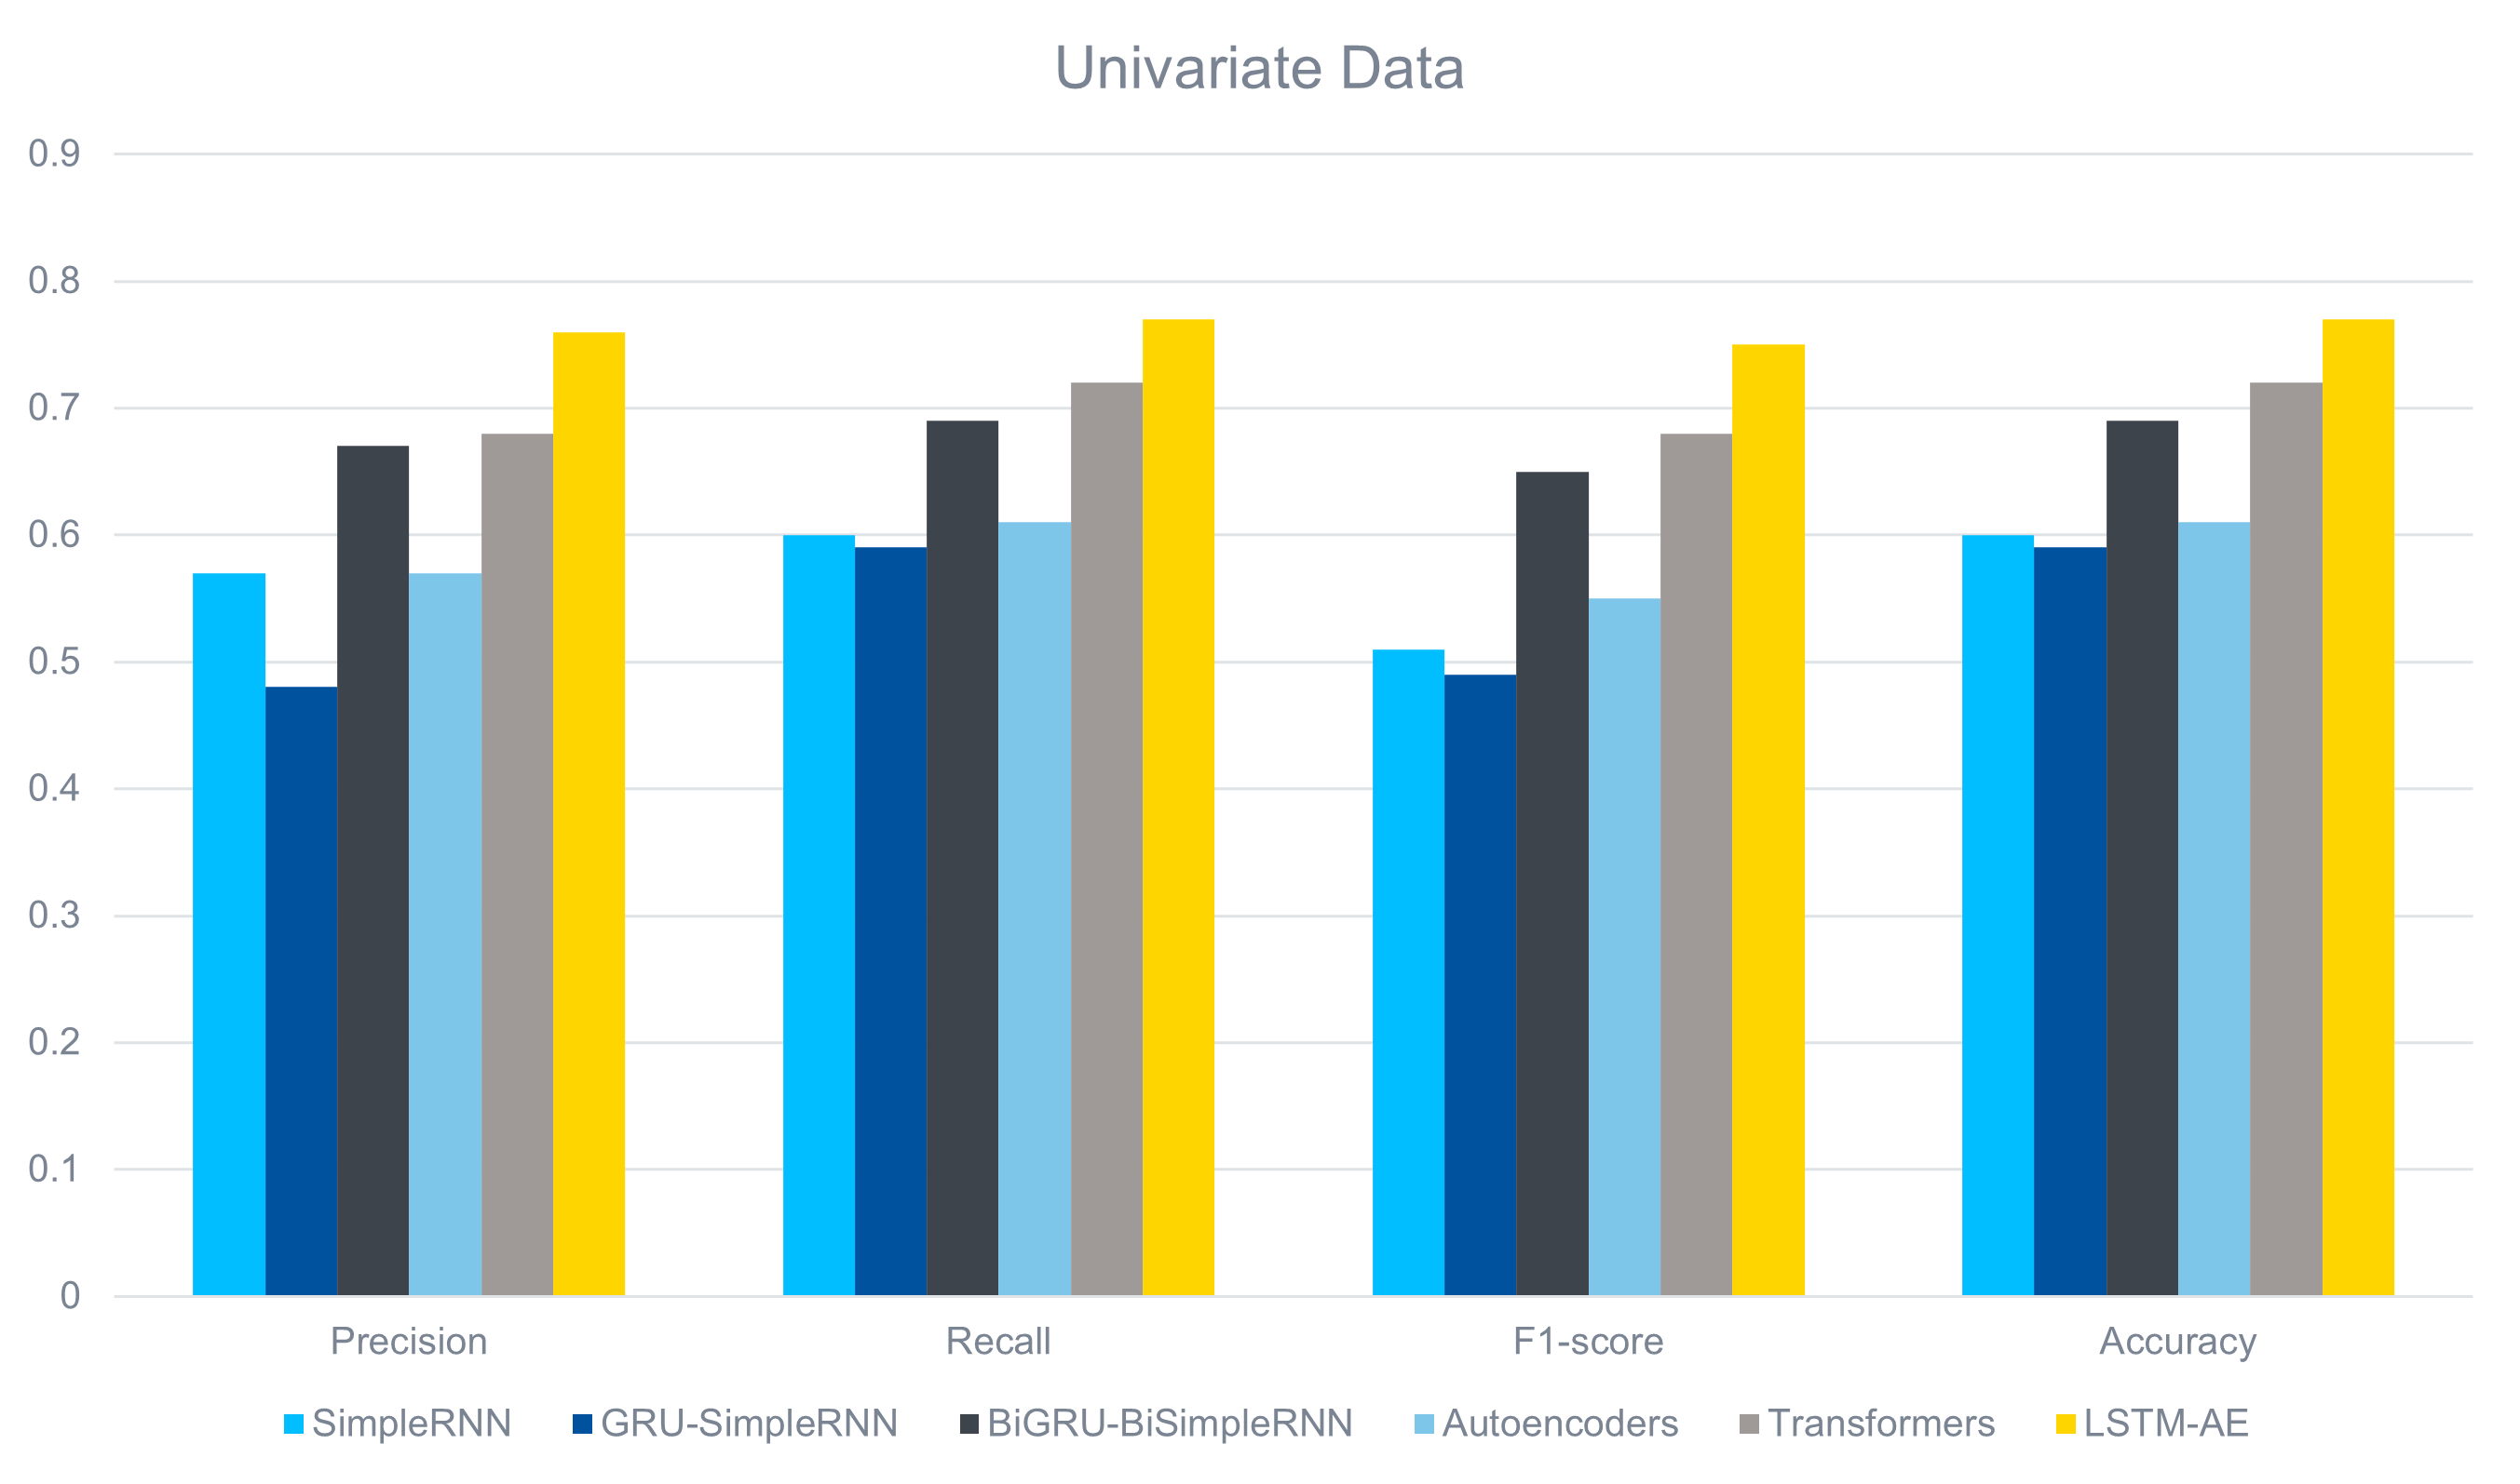
Comparison between DL Models for Univariate Data

Slide 31
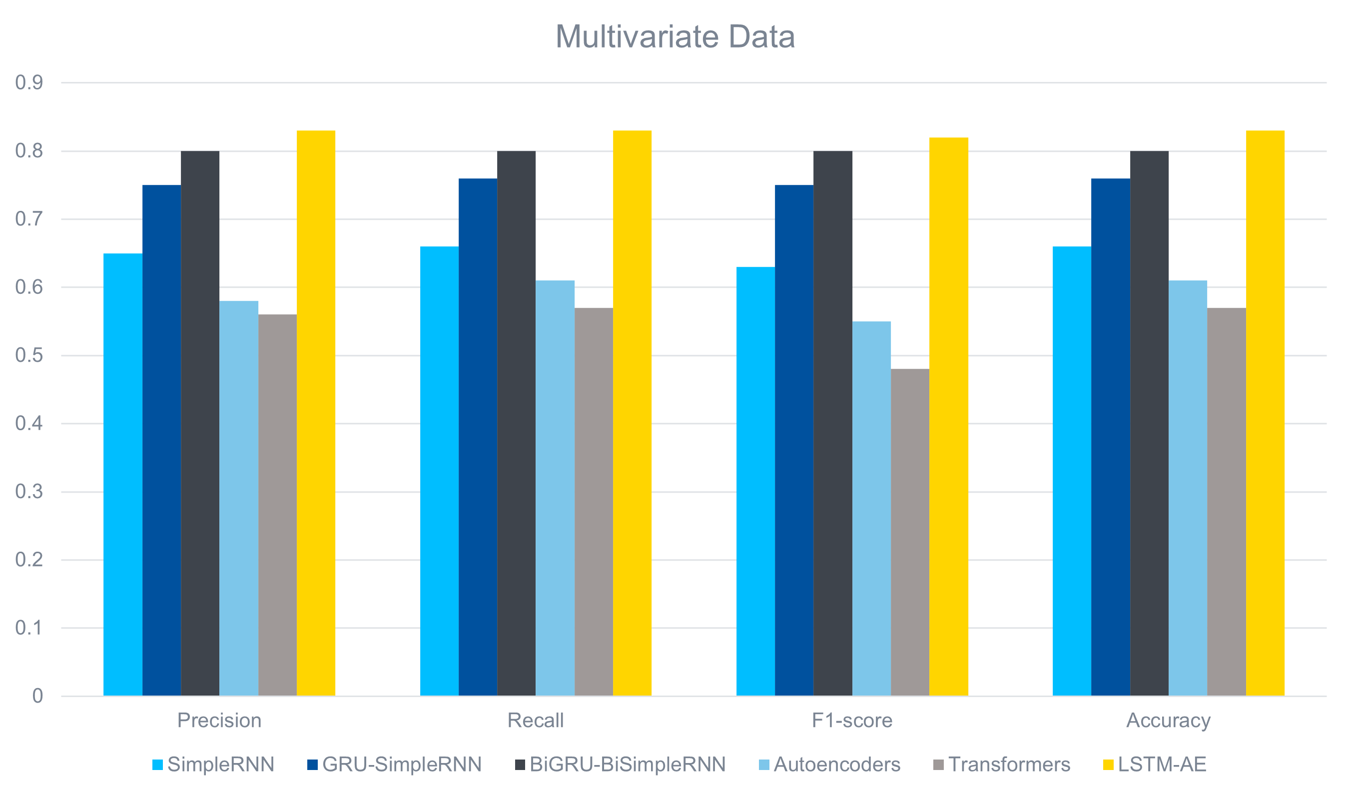
Comparison between DL Models for Multivariate Data

Slide 32
CONCLUSION & FUTURE SCOPE

Slide 33
Conclusion
01
The Traffic Model of MOBATSim consisting of 10 vehicles with 3 different scenarios is adapted. Sensor Faults are injected using FI block at speed and distance sensor of Vehicle 2 and vehicle 6 .
02
Faulty and Fault-Free (univariate and multivariate) data is generated and eventually, labeled and pre-processed
03
Simple RNN, GRU-Simple RNN, Bidirectional GRU-Bidirectional Simple RNN, Autoencoders, Transformer-based classifier and LSTM-Autoencoder architectures are used for training both types of data.
04
LSTM-Autoencoders perform the best out of all the DL models used for both types of data giving an accuracy of 77% with univariate data and 83% with multivariate data.

Slide 34
Future Scope
Data Collection with different changes in the Vehicle Model for MOBATSim
Other fault types like hardware and network faults can be implemented.
Other DL and ML models can be used for fault classification.
Different pre-processing methods can be used for other architectures

Slide 35
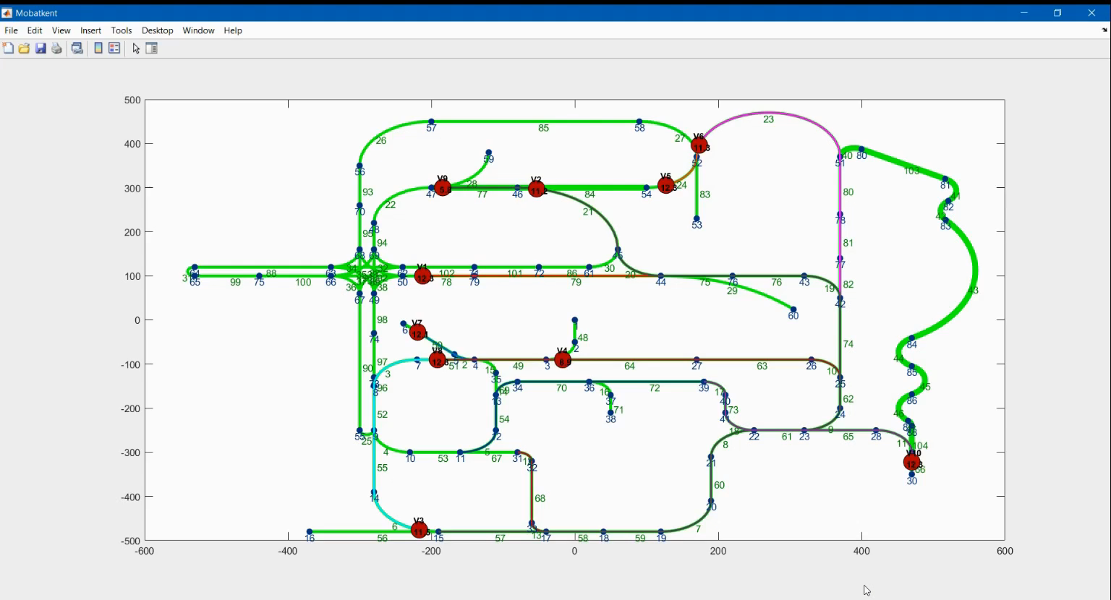
Demonstration Video

Slide 36
REFERENCES
[1] https://mobatsim.com/
[2] Deep Learning-Based Anomaly Detection in Cyber-Physical Systems: Progress and Opportunities, Yuan Luo, Ya Xiao, Long Cheng, Guojun Peng, Danfeng Daphne Yao, arXiv:2003.13213v2 [cs.CR]
[3] http://www.sciencedirect.com/science/article/pii/S2405896319304100“
[4] Monostori L. (2018) Cyber-Physical Systems. In: The International Academy for Production, Chatti S., Tolio T. (eds) CIRP Encyclopedia of Production Engineering. Springer, Berlin, Heidelberg. https://doi.org/10.1007/978-3-642-35950-7_16790-1
[5] A. Nanduri and L. Sherry, "Anomaly detection in aircraft data using Recurrent Neural Networks (RNN)," 2016 Integrated Communications Navigation and Surveillance (ICNS), 2016, pp. 5C2-1-5C2-8, doi: 10.1109/ICNSURV.2016.7486356.
[6] https://medium.com/@felixs_76053/bidirectional-gru-for-text-classification-by-relevance-to-sdg-3-indicators-2e5fd99cc341
[7] “LSTM-Autoencoder based Anomaly Detection for Indoor Air Quality Time Series Data”, Yuanyuan Wei, Julian Jang-Jaccard, Wen Xu, Fariza Sabrina, Seyit Camtepe, Mikael Boulic, arXiv:2204.06701v1 [cs.LG]
[8] “TranAD: Deep Transformer Networks for Anomaly Detection in Multivariate Time Series Data” , Shreshth Tuli, Giuliano Casale, Nicholas R. Jennings, arXiv:2201.07284v6 [cs.LG]
[9] https://towardsdatascience.com/anomaly-detection-using-autoencoders-5b032178a1ea

Slide 37
THANK YOU

